Slide 1
Project api Disney

Slide 2
LIBRARIES USED
‘ArduinoJson.h’ – for parsing JSON data
‘WiFiClient.h’ si ‘WiFi.h’ –for connecting to WIFI
‘HTTPClient.h’ –for making HTTP rqeust
‘WebServer.h’ –for creating an Arduino server

Slide 3
Handleroot function,requesting http and json parsing
“ void handleRoot() “ - This function handles the request at the root of the server and builds a dynamic HTML page.
“HTTPClient http;http.begin("http://proiectia.bogdanflorea.ro/api/disney-characters/characters"); int httpCode = http.GET(); » - An HTTP GET request is made to the API, and it is checked whether the response is valid.
‘’ DynamicJsonDocument doc(8192);DeserializationError error = deserializeJson(doc, http.getString()); - We use ArduinoJson to parse the JSON response received from the API.

Slide 4
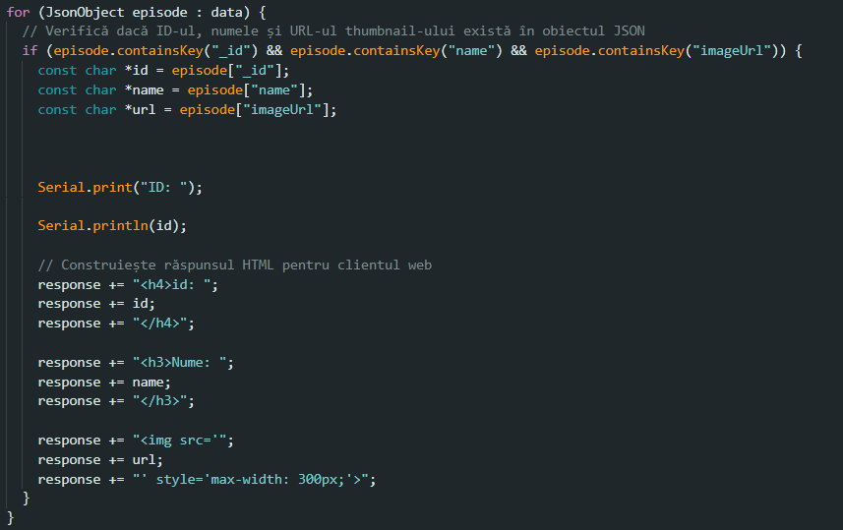
Generating HTML response
Functionality: Retrieval and Verification: The character data is retrieved and the presence of the necessary keys is verified. Dynamic HTML Construction: An HTML is built for each character with their ID, name, and image. Web Display: The constructed HTML is sent as a response to the client's request, displaying the Disney characters.

Slide 5
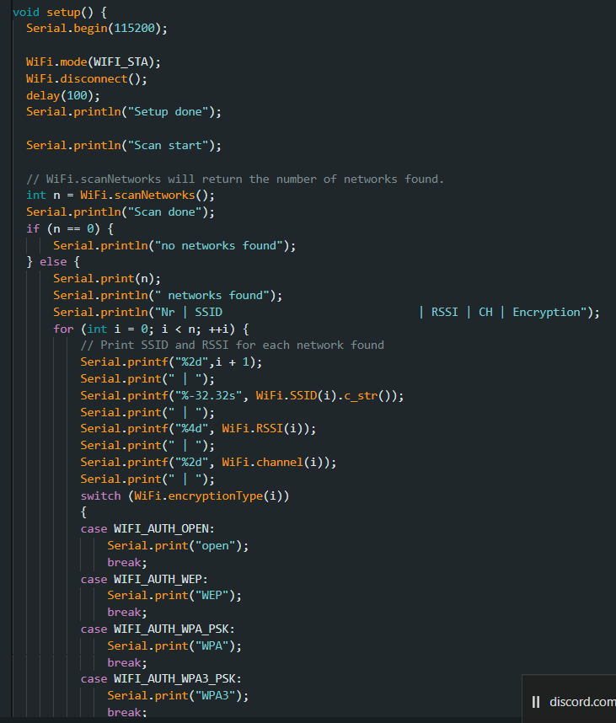
Configuring wifi
Functionality: Initialization and Scanning: Initializes serial communication and scans available WiFi networks, displaying information about them. WiFi Connection: Connects to the specified WiFi network and displays the obtained IP address. Server Startup: Configures and starts the web server to respond to requests.

Slide 6
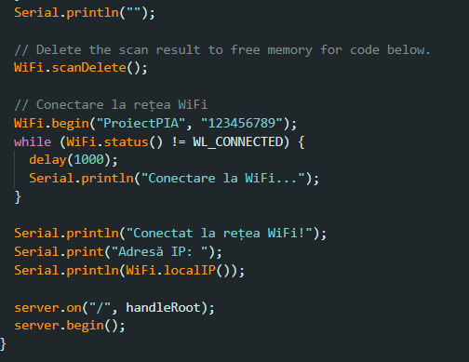

Slide 7
Thank you for fallowing

